Slide 1
System evaluation
How can we measure the solution quality?
Target: You developed a new search engine. You must define how well it works.

Slide 2
You ran a search test for the word “cat”.
After the test ran, the search engine retrieved the documents that are shown here

Slide 3
How many relevant documents were retrieved by the algorithm?
150 documents → True positive (Tp).
How many irrelevant documents were retrieved by the algorithm?
100 documents → False positive (Fp)
How many relevant documents did the algorithm not retrieve?
50 documents→False negative (Fn).
How many irrelevant documents did the algorithm not retrieve?
700 documents→True negative (Tn).

Slide 5
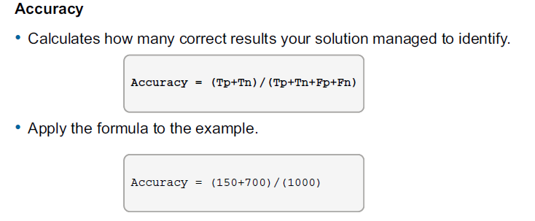
Accuracy calculation

Slide 6
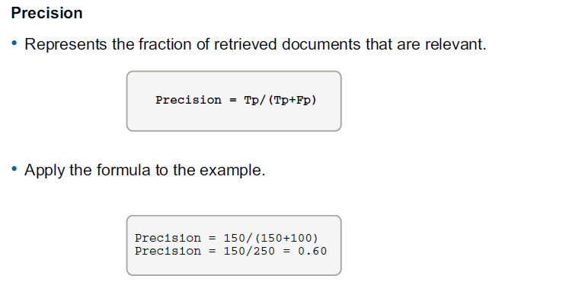
Precision Calculation

Slide 7
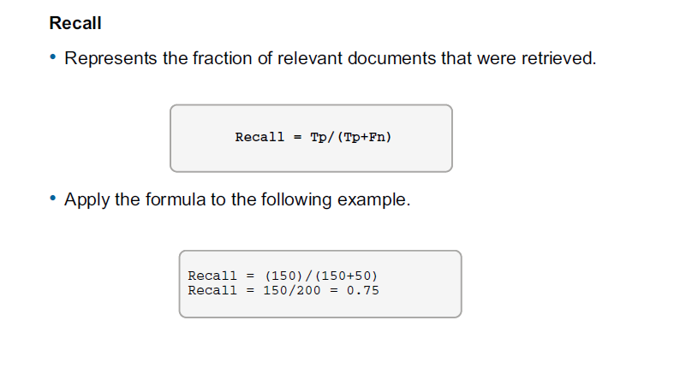
Recall Calculation

Slide 8
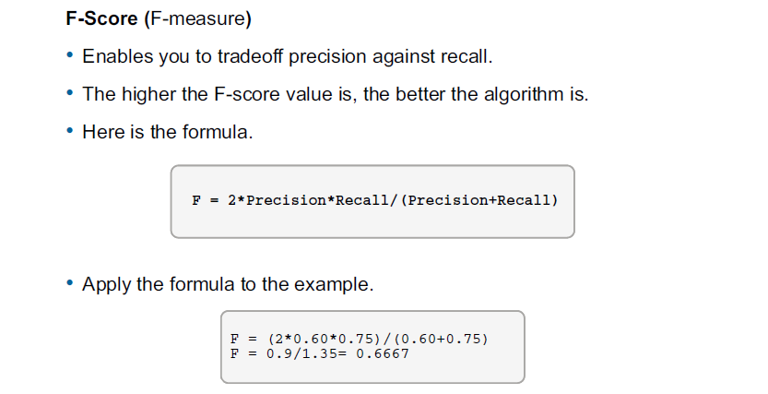
F-Score Calculation

